Slide 1
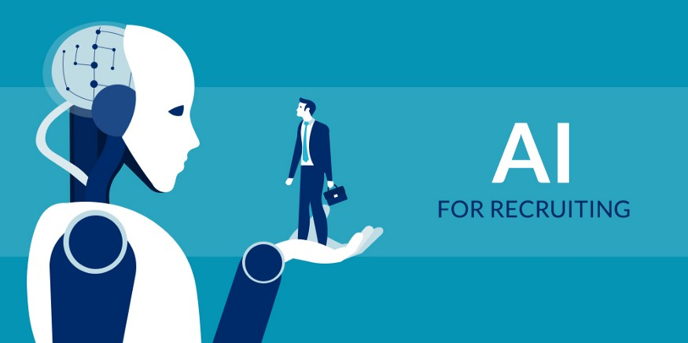
SMART HR

Slide 2
PROSPECTS
Introduction
Abstract
Watson assistant
Node red
How website looks
Advantages
Conclusion

Slide 3
Introduction
The Project is AI-Recruiter shortlist a candidate for a specific job role.
The main theme of this project is conducting a HR interview through online.
It was designed by using Watson Assistant and Node-red flow.
It is very difficult to conduct an interview on this critical COVID-19 Pandemic Situations But the interview through AI-Recruiter makes it easy.

Slide 4
Abstract
Job seekers can easily access the interview through online and get effective experience as they get call back about their performance.
They can visit it virtually no need to go anywhere.
Here mainly focused on trendy languages and communication skills.

Slide 5
Watson Assistant
Here we created AI-Recruiter using Watson Assistant given by IBM Cloud.
In this we collect difficulty interview question and answers and added in intents and entities.
Each answer is stored in intents and all possible answers are added in entities.
All intents and entities are integrated with dialogs. Based on the questions we add required dialogs.
In this AI-Recruiter first we add personal details questions and communication skills questions later that we add programming language questions that is the user choice.

Slide 6
NODE-RED
The Node-Red flow is integrated with Watson Assistant.
In this we use all required nodes to input parsing to output parsing and also we use Assistant node. For image purposes we add template node.
The purpose of using Assistant node is to link Watson Assistant to node-red flow.
The output is stored in the node-red dashboard to showcase in the form of Website

Slide 7
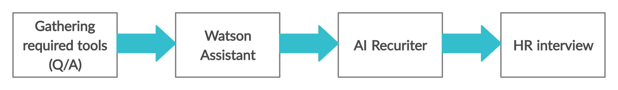
Block Daigram

Slide 8
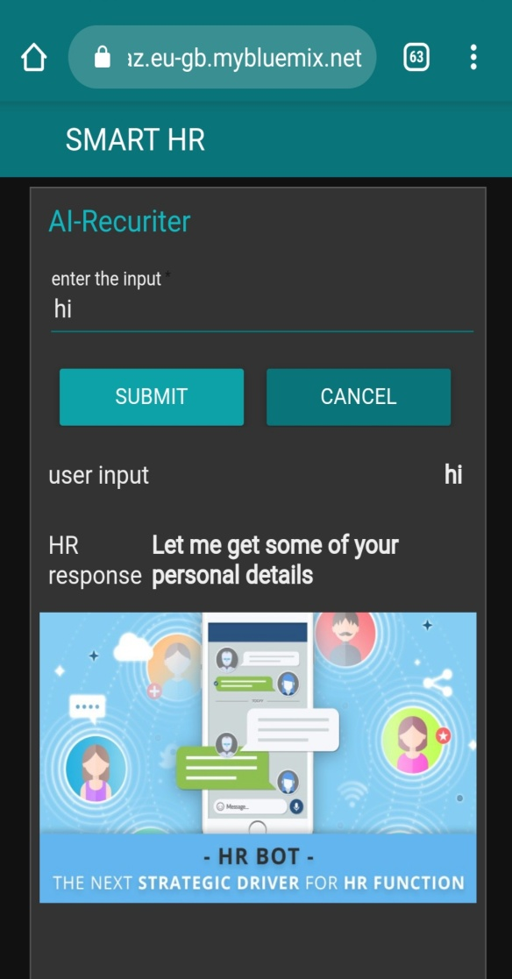
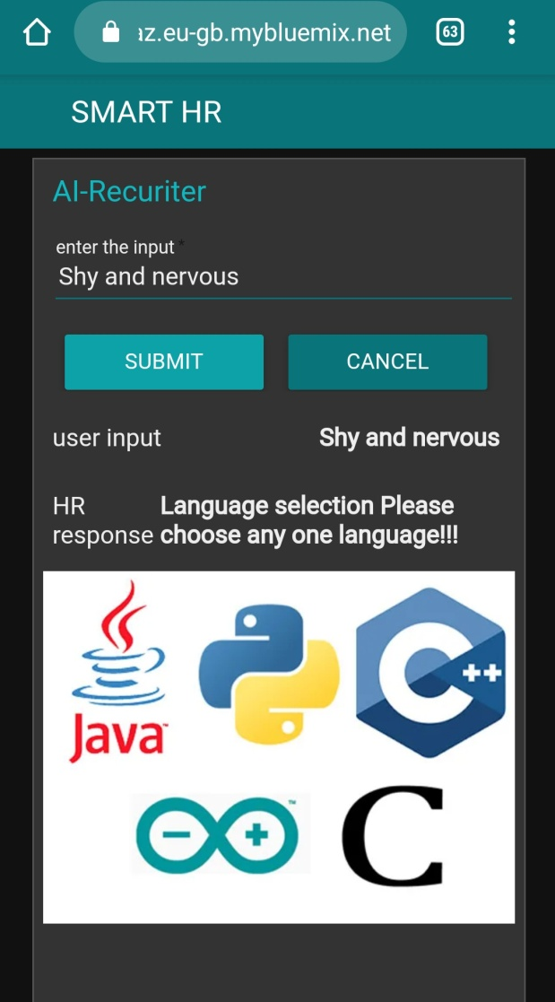
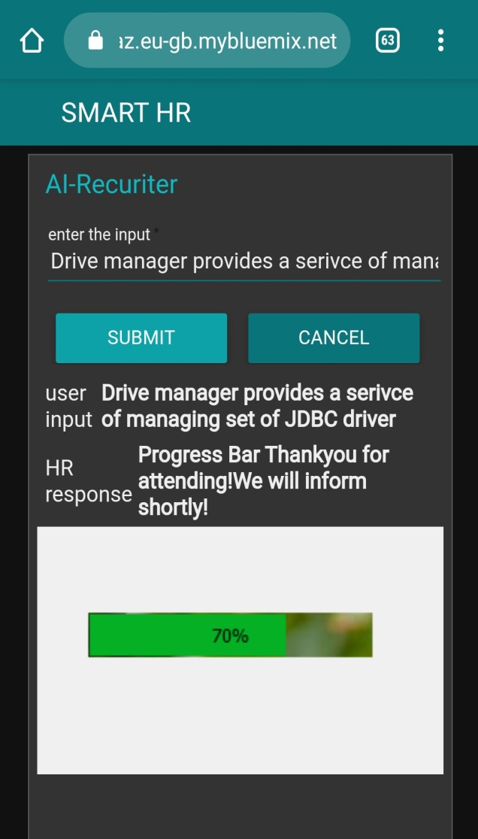
How website looks

Slide 9
Advantages
The benefits of using AI include saving recruiters’ time by automating high-volume tasks and improving quality of hire through standardized job matching.
It majorly helps to make a schedule for an interview and provide instant solution.
It was very useful for the tough situations and persons can get better experience and it makes easier for selection process to the interview.

Slide 10
Conclusion
It is a HR interview conducting through AI-Recruiter.
It is conducted for the Persons those who clears their written test.
AI for recruiting are intelligent screening software that automates resume screening, recruiter chat Bots that engage candidates in real-time, and digitized interviews that help assess a candidate’s fit.
AI-powered chat Bots have a lot of potential to improve the candidate experience.

